Slide 1

EXODUS
EXODUS
A film Written and Directed by Vince Remo
Logline
When a detached man lives his life in a simulation he begins to recover memories of his past life, and uncovers a conspiracy that reveals not only his own murder but a coming cataclysm that threatens both digital avatars and the “real” world.

Slide 2
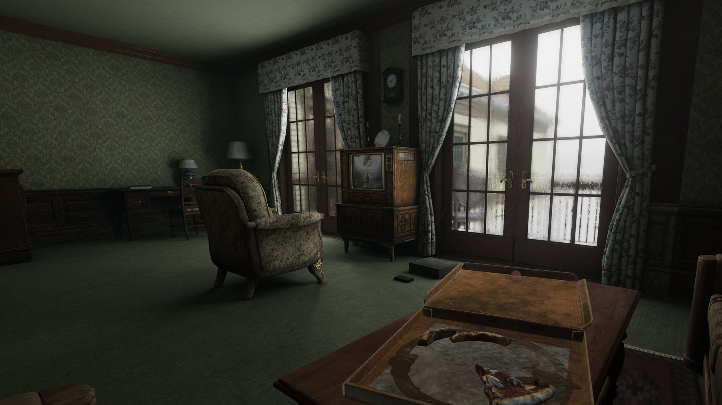
Overview
Exodus is a 20 page, sci-fi psychological thriller that explores love, memory, and what it means to be truly alive in a world blurred between simulation and reality. Blending emotional intimacy with high-concept science fiction, the short film raises provocative questions about digital identity, AI, and the soul.

Slide 3

Why This Film Matters
We are at the cusp of an AI-driven era where lives are lived, recorded, and replicated online. Exodus dramatizes this by exploring:
The fragility of memory and how technology can manipulate it.
The commodification of identity through social media algorithms.
The enduring resilience of the human spirit, even when trapped in artificial constructs.
Audiences today are hungry for films that combine emotional depth with speculative science fiction — in the spirit of Black Mirror, Ex Machina, and The Matrix. Exodus is designed to resonate both as a gripping narrative and as social commentary.

Slide 4


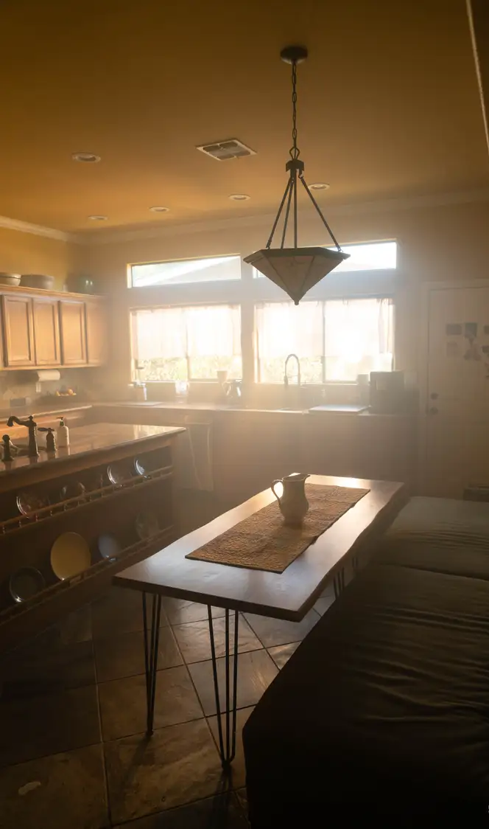
Visual Style & Tone
Atmosphere: A haunting blend of realism and surrealism. Domestic, grounded spaces that transform into uncanny digital environments.
Look: Clean, modern production design contrasted with warm vintage look.
Tone: Intimate performances juxtaposed with an existential unease that builds to an apocalyptic climax.

Slide 5

Film Logistics
20 page short script
Estimated Production Cost $30,000
4 principal characters
10 backgrounds
3 locations
3 days filming
Crew
Cinematographer
Cameraman
Sound
Lighting
Key Grip
Makeup
Production Design

Slide 6



CHARACTERS
Adama
Eva
Lilith

Slide 7

MEET THE WRITER AND DIRECTOR
Vince Remo is a filmmaker and accomplished writer with over two decades of experience. Based in San Clemente, California, he is the creative force behind We Will Win Films, specializing in screenwriting, film production and visual effects. Vince has directed and produced a diverse array of content, including commercials, music videos, and short films, earning a reputation for high-quality visual storytelling.
​
His work is known for its cinematic quality, thoughtful composition, and meticulous editing. Hi last film “INSENTIENT” is currently in the running in the film festival circuit. He is also a skilled project coordinator, having managed teams of artists, writers, and animators to bring projects from concept to completion. Vince will be Directing and Editing Exodus.
​
Largely self-taught, he continuously expands his knowledge through books and online courses. His interests include culinary arts, drawing, video games and music, reflecting his multifaceted creativity.

Slide 8

Exodus isn’t just a short film — it’s an immersive experience that challenges how we perceive love, death, and reality itself. By supporting this project, you’ll help bring to life a story that feels both urgent and eternal.

